Slide 1

Programming Exercises using OpenCV tutorial week 4

Slide 2
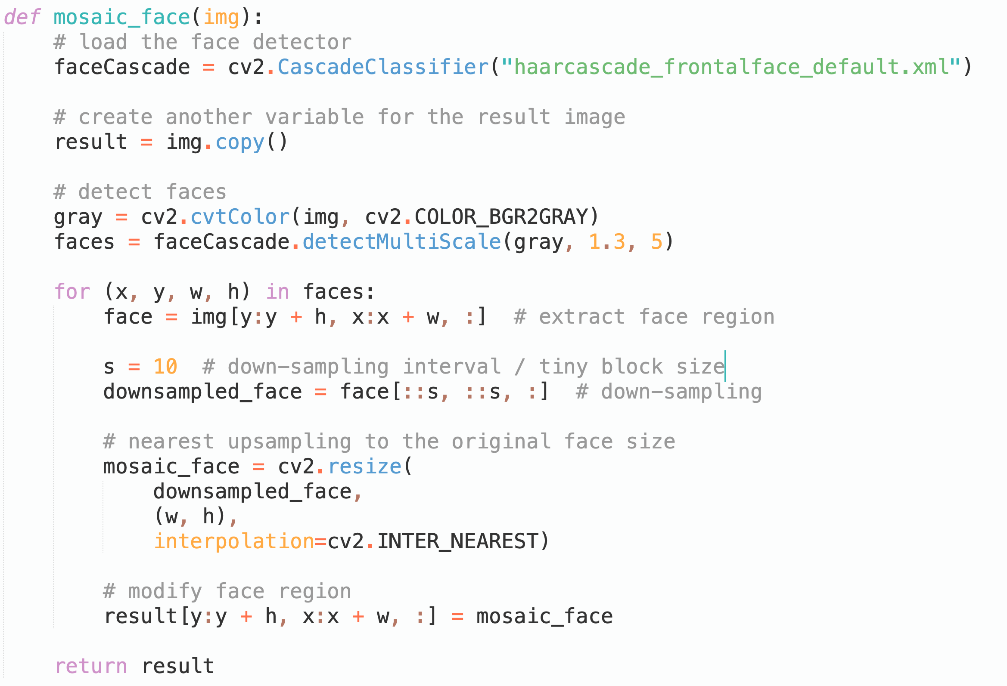
ex1
Notes:
For the first exercise, we have to replace the face region of this picture with corresponding mosaic to protect the privacy.
The larger down-sampling interval s we set, the more blurry the resulting image will be.

Slide 3
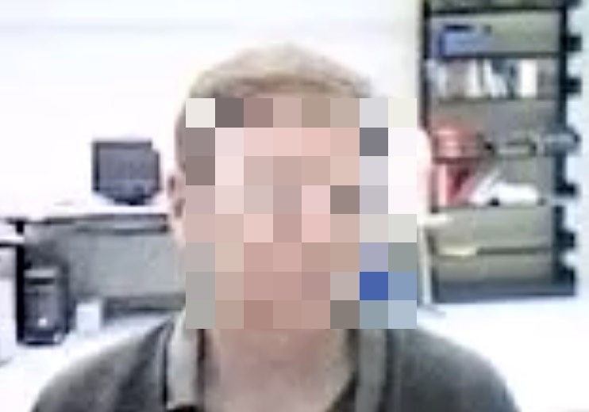
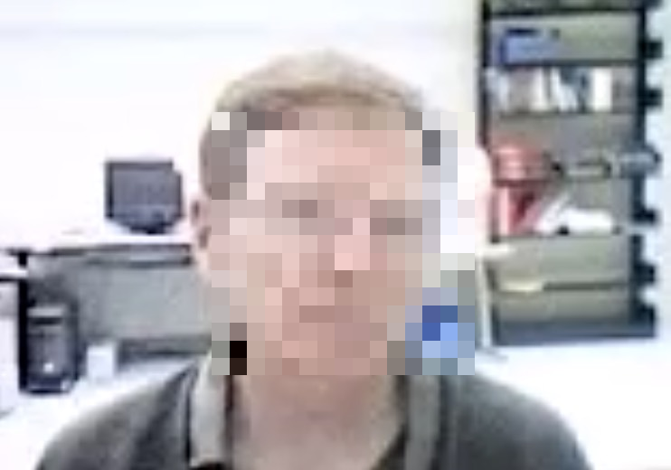

S = 40
S = 20
S = 10

Slide 4
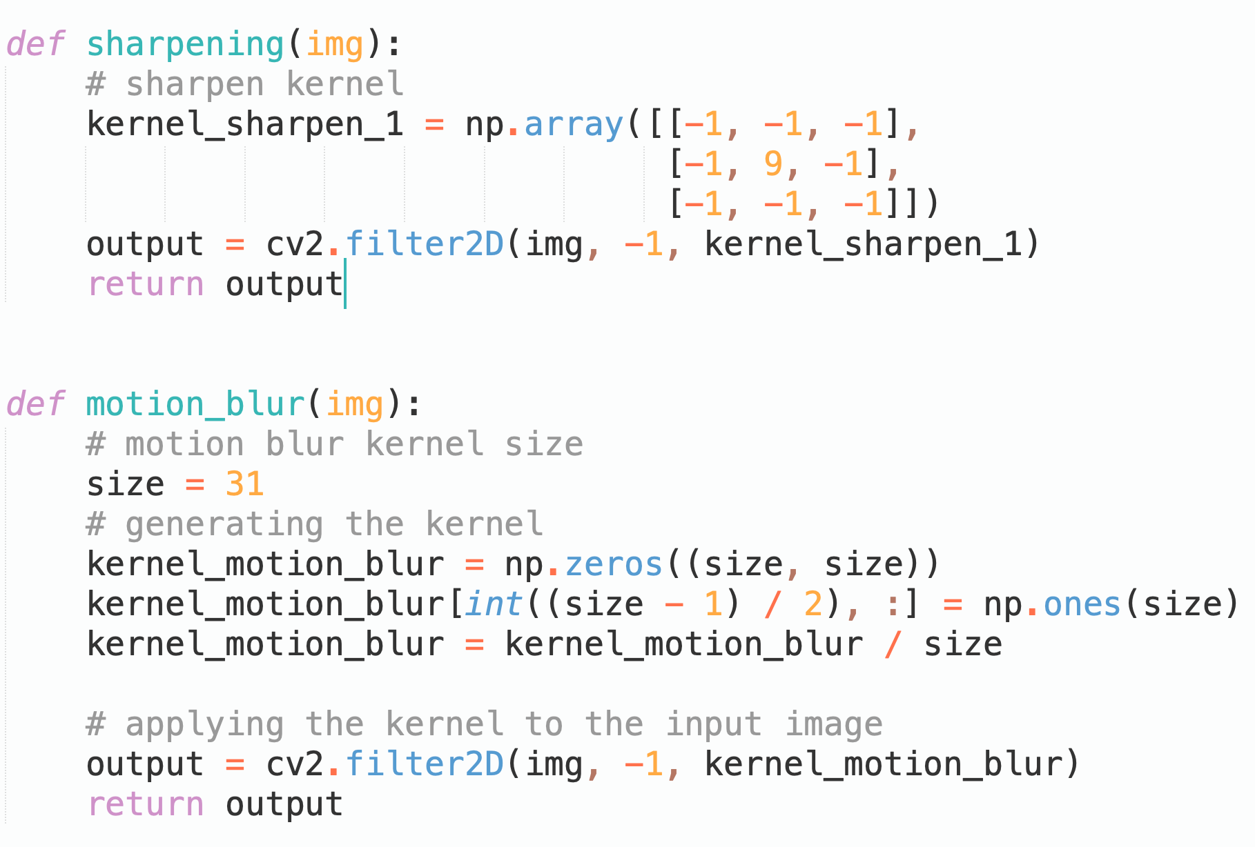
ex2
when ddepth=-1, the output image will have the same depth as the source.
Notes:
The first thing we need to do is to define the sharpening kernel, we just use the 3by3 one we have learned in lecture.
We create a 2d numpy array to store it.
Then we use cv2.f …
It has 3 input parameters (introduce …)
I think it is quite straightforward

Slide 5
ex2
when ddepth=-1, the output image will have the same depth as the source.
: 0
: 1/size
Notes:
For the Motion blur task, it could be regarded as a kind of blur that only happened in one direction
We have learned Guassian blur in the lecture, we average the small region in all directions, but to add motion blur, we only want to do averaging in one specific direction. For exm, the horizontal.
So we create a 2D kernel that has non-zero values in the middle row.
The larger the kernel size we set, the more obvious the motion blur will be.

Slide 6
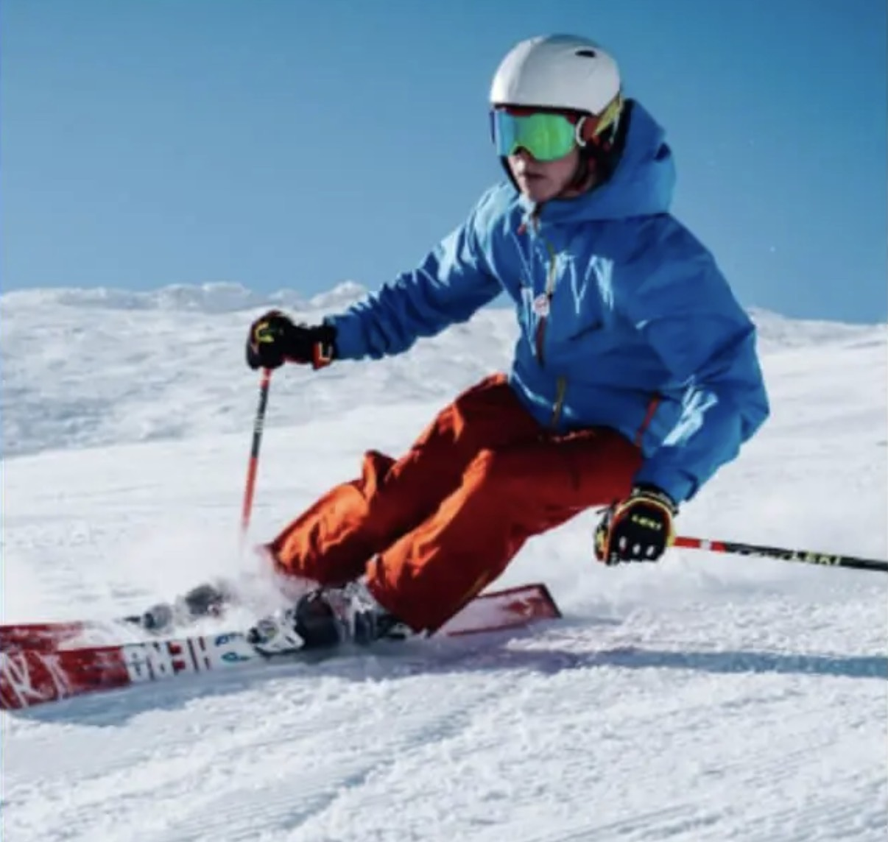



Original
Sharpening
Motion blur
K=31
Motion blur
K=51

Slide 7
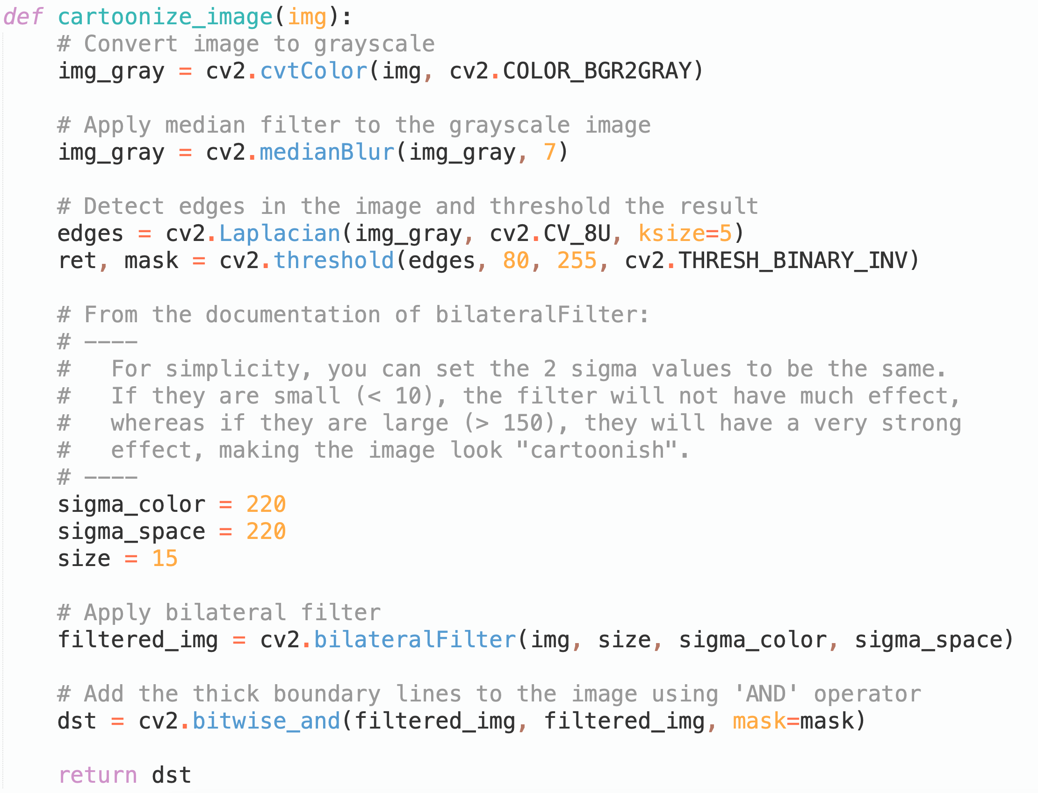
ex3
Notes:
In order to complete the last programming exercise, we can use Laplacian and bilateral filters for this task.

Slide 8
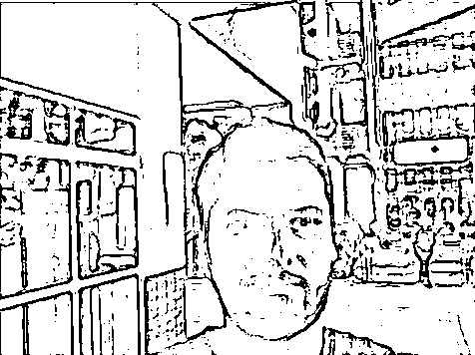
ex3
Notes:
First, we use the median filter to reduce the image noise.
And then, we apply the Laplacian filter to detect the edges.

Slide 9
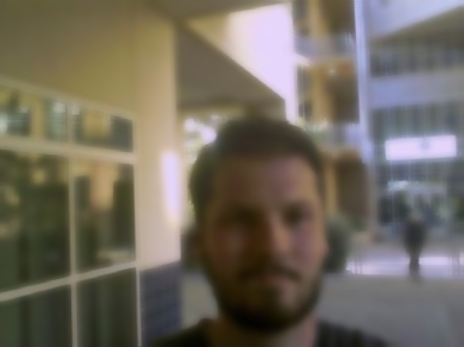
ex3
Notes:
Next, we can use the bilateral filter to keep the edges intact.

Slide 10
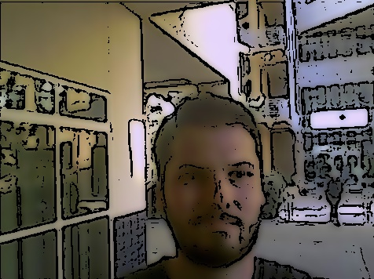
ex3
Notes:
Finally, we can obtain the result by combing these two filtered images.

Slide 11

Original
Cartoonized

